Slide 1















Factors Affecting Nursing Students' Knowledge About Handling Sports Injuries
Presenter : Marwan Tasnim¹
Dr.Lisna AnisaS.Kep.,Ners., M.Kes. AIFO²,Slamet Rohaedi, S.Kep., M.P.H³,
Sri Sumartini S.Kep., Ners., M.Kep⁴
Notes:
This presentation explores the diverse factors influencing nursing students' comprehension of sports injuries. Understanding these influences is crucial for optimizing education and equipping future healthcare professionals to effectively manage sports-related conditions.

Slide 2

Introduction
Knowledge about handling sports injuries is very important for nursing students of UPI who are widely involved in sports activities. This study aims to analyze the influence of factors that influence students' knowledge in handling injuries. The factors that influence knowledge are internal factors including education, experience, age, interests and external factors including mass media/information, socio-culture, economy and environment. The research method uses a cross-sectional approach on 84 nursing students of UPI. The instrument uses a questionnaire of 90 questions. The data processing method uses the t-test. The results of the study showed that internal and external factors influenced students' knowledge in handling sports injuries where the significance value was less than 0.05 (p <0.05), so it can be concluded that internal and external factors have a positive and significant effect both partially and together on nursing students' knowledge about handling sports injuries. This indicates that when the internal and external factors possessed by nursing students are getting better, the knowledge of nursing students about handling sports injuries will also be better, and vice versa, if the internal and external factors possessed by nursing students are getting worse, the knowledge of nursing students about handling sports injuries will also be worse, but it is recommended that research be conducted on students with a larger number of respondents.

Slide 3
Literature Review
Name
Title
Result
________________________________________________________________________________________________
The level of knowledge of sports practitioners in Buleleng Regency in providing first aid for sports injuries using the RICE method’s (2020)
The results of this research are that students' knowledge of injury management regarding the RICE method using rest is good (42.0%), ice is in the good category (53.6%), compress is in the very good category (66.7%), and elevation is in the good category. sufficient (50.7%). The description of knowledge of first-hand treatment of sports injuries in sports SMEs is in the good category
Jovi Hardyanto , Novita Nirmalasari
1..
________________________________________________________________________________________________
Muhammad Oktavian
Level of Understanding of Acute Injury Management Using the R.I.C.E Method in Yanitra FC Sidoarjo Futsal Players Aged 16-23 Years (2021)
The results of the study focus on the understanding of futsal players in dealing with sports injuries both during competition and practice.
2.
___________________________________________________
___________________________________________________
________________________________________________________________________________________________
3.
Muhammad Oktavian , Joesoef Roepajadi
Level of Understanding of Acute Injury Management Using the R.I.C.E Method in Yanitra FC Sidoarjo Futsal Players Aged 16-23 Years (2021)
Based on the results of this research, the results of the research show that the level of understanding of acute injury management using the RICE method is that 7 players (43.75%) are in the "Very Good" category, 8 players (50%) are in the "Good" category while 1 player (6.25% ) belongs to deep
________________________________________________________________________________________________
Level of Knowledge of Handling Sports Injuries in Students
Based on the results of this study, it shows that the level of knowledge of handling sports injuries using the protect, rest, ice, compression, elevation, support methods among FIO UNESA students class of 2016 is included in the very high category at 27.8% (25 students), in the high category at 58, 9% (53 students), the medium category was 13.3% (12 students), and the low and very low category was 0% (0 students).
Ruchy Pharamanandya Okta Soetanto Hartono
4.

Slide 4
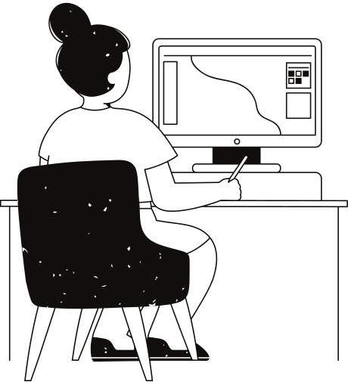
Methode
Research design is a design used to solve a problem in a research to a desired goal. The approach taken in this study is a quantitative approach. This study uses a double linear regression analysis method because the free variable consists of more than one.
Assessing normality is a vital step in statistical analysis to confirm that data conforms to a Gaussian distribution, which is a key assumption for parametric tests like ANOVA. Tests such as Kolmogorov-Smirnov test help determine if the data is normally distributed, ensuring the validity of subsequent analyses. Deviations from normality can undermine the accuracy of these tests, leading to potentially misleading results.
Reliability testing, such as using Cronbach's alpha, verifies the consistency of measurement tools. High reliability indicates that the instrument consistently measures the intended construct. Additionally, ANOVA (Analysis of Variance) compares means across multiple groups to identify significant differences. Together, normality and reliability checks, along with ANOVA, ensure robust and credible results in statistical analysis.

Slide 5
  Findings
Population and sample
01
Nursing students 2020 to 2023 total 328. sampling with accidental samplings with Slovenian formula 10% error rate obtained as many as 84 students
The criteria for qualifying as a sample in the research, the criteria that are active students willing to be respondents
Factor Internal (X1) and Factor Eksternal (X2)
1) Education
2) Experience
3) Age
02
1) Media/information
2) Social Culture
3) Economics
4) Environment
03
Operational Variable
Factor Internal (X1) Factor Eksternal (X2)
1) Education (+ 1,2,3,6) (-4,5,7)
2) Experience (+8,9,10,11,12,13) (-14,15)
3) Age (+18,20) (-16,17,19,21,22)
4) interest (+23,24,25,28) (- 26,27,29,30)
1) Media/information ) (+ 1,2,3,6,7,8) (- 4,5)
2) Social Culture (+9,10,14) (- 11,12,13)
3) Economics (+ 16,17,21) (- 13,15,18,19)
4) Environment (+ 22,23,24,27,28,29,30) (- 20,21,25,26

Slide 6

Findings
demographic characteristics of respondents
1. age
2. gender
3. generation 2020, 2021, 2022, 2023
4. have attended sports nursing courses
Respondent characteristics
Extent Gender
2020 (25%) Male (7,2%)
2021 (26,2%) Female (92,2%)
2022 (26,2%)
2023 (22,6%)
It is known that the results of respondents regarding student internal factors were less than 62 points, the highest score was 107 points with an average score of 89.99 with a standard deviation of 8.753

Slide 7

Findings
Internal Factors | Eksternal Factors | Knowledge About Sports Injury Management
the results of respondents' responses regarding Internal factors for nursing students had the lowest score of 55, the highest score was 100 with a, the average was 78.708 with a standard deviation of 8.476. The average score is 78.708 in the 66-79 interval so that nursing students' knowledge about treating sports injuries is in the good category. | the external factors of nursing students had the lowest score of 62, the highest score was 109 with a total score of 7,520 so the average was 89.52 with a standard deviation of 8.151. The total score is 7.520 in the interval 6.001-7.800 so that the external factors of nursing students are in the good category. | The lowest score for external factors for nursing students is 55, the highest score is 100 with a total score of 6,611.50 so the average is 78.708 with a standard deviation of 8.476. The average score is 78.708 in the 66-79 interval so that nursing students' knowledge about treating sports injuries is in the good category.

Slide 8
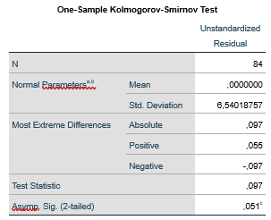
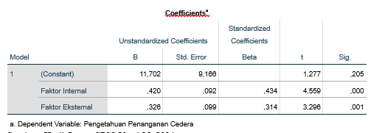
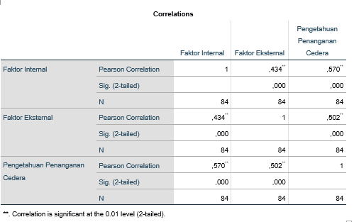
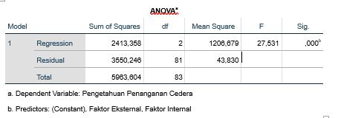

  Discussion
Notes:
normality test
Based on the table above, it shows that the value of Asymp. Sig.(2-tailed) is 0.051, this value is > 0.05. So it can be concluded that the residual value is normally distributed or the normality test is fulfilled. In this research, apart from using histogram graphs and P-plot graphs.
Correlations
It is known that the rcount value for the Internal Factor variable is 0.570 when compared with the rtable value (n=84) of 0.215, so rcount > rtable or 0.570 > 0.215, so there is a relationship between internal factors and nursing students' knowledge about treating sports injuries. Furthermore, the rcount value for the External Factor variable is 0.502 when compared with the rtable value (n=84) of 0.215, so rcount > rtable or 0.502 > 0.215, so there is a relationship between external factors and nursing students' knowledge about treating sports injuries

Slide 9
Conclution
Based on the conducted study, the author has concluded that both internal and external factors significantly and positively affect nursing students' knowledge of sports injury management, both individually and collectively. This indicates that as the internal and external factors possessed by nursing students improve, their knowledge of sports injury management also improves. Conversely, if these internal and external factors deteriorate, their knowledge of sports injury management also declines. so will the nursing students' knowledge of sports injury management.

Slide 10
Arikunto Suharsimi. (2020). Prosedur Penelitian Pendekatan Praktek. In Jakarta: PT Rinneka Cipta.
Dr Sugiyono. (2019). Metode Penelitian Kuantitatif Dan Kualitatif Dan R&D. Bandung. Penerbit: CV Alfa Beta.
Ilham, Z. (2023). Penanganan Pada Cedera Olahraga. Cipta Media Nusantara.
Imam. (2021). Aplikasi Analisis Multivariate Dengan Program IBM SPSS 26. Edisi 10. Badan Penerbit Universitas Diponegoro.
Khurana, A., Singh, I., & Singh, M. S. (2021). Is anterior and posterior ankle impingement under-diagnosed? A review. Journal of Arthroscopic Surgery and Sports Medicine, 2. https://doi.org/10.25259/jassm_50_2020
Kusuma, M. R., Junaedi, J., & Setiakarnawijaya, Y. (2017). Pemahaman Penanganan dan Pemberian Pertolongan Pertama dala Cedera Olahraga pada Anggota PMR SMP Negeri 20 Jakarta. Jurnal Segar, 5(1). https://doi.org/10.21009/segar.0501.02
Latip, A. E. (2020). Evaluasi Pembelajaran Inovasi Penilaian Hasil Belajar. Puslitpen LP2M UIN Syarif Hidayatullah Jakarta.
Muhibbi, M., Yogaswara, A., Fariz, S., & Pratama, Y. E. (2023). Pendampingan Pencegahan dan Perawatan Cedera Olahraga Melalui Sport Massage pada Atlet PABERSI Kabupaten Jepara. Jurnal Pengabdian Olahraga Masyarakat (JPOM), 4(1). https://doi.org/10.26877/jpom.v4i1.14756
Mustafa, P. . (2019). Buku Ajar Pertolongan Pertama Dan Pencegahan Perawatan Cedera Olahraga. Insight Mediatama.
Pariati. (2022). mbaran Pengetahuan Kesehatan Gigi Dengan Penyuluhan Metode Storytelling Pada Siswa Kelas III Dan IV SD Inpres Mangasa Gowa. Media Kesehatan Gigi, 19(02), 7–13. https://doi.org/10.32382/mkg.v19i2.1933
Puspitasari, N. (2019). Faktor Kondisi Fisik Terhadap Resiko Cedera Olahraga Pada Permainan Sepakbola. Jurnal Fisioterapi Dan Rehabilitasi, 3(1). https://doi.org/10.33660/jfrwhs.v3i1.34
Rahman, A. A., & Nasryah, C. E. (2019). Evaluasi Pembelajaran. In Uwais Inspirasi Indonesia.
Rias Gesang Kinanti. (2020). Penananganan Cedera Olahraga Untuk Pembina Pelatih dan Atlet. Wineka Media.
Ridha, S., & Rachman, A. (2023). SURVEI LOKASI DAN PENYEBAB CEDERA OLAHRAGA PADA ATLET CABANG OLAHRAGA PERMAINAN. Jambura Sports Coaching Academic Journal, 2(1). https://doi.org/10.37905/jscaj.v2i1.20614
Setyaningrum, D. A. W. (2019). Cedera olahraga serta penyakit terkait olahraga. Jurnal Biomedika Dan Kesehatan, 2(1). https://doi.org/10.18051/jbiomedkes.2019.v2.39-44
Surur, M., & Gustiawati, R. (2023). Analisis penerapan biomekanika terhadap pencegahan cedera olahraga dalam pembelajaran Pendidikan Jasmani. Sriwijaya Journal of Sport, 2(2). https://doi.org/10.55379/sjs.v2i2.722
Widhiyanti. K. A. T. (2019). Cedera Olahraga Pencegahan Dan Perawatan. Pustaka Panasea.
Wijaya, R. A. (2023). Identifikasi Cedera Pada Siswa Sekolah Sepak Bola Indonesia Muda Di Kabupaten Purworejo Tahun 2021. Indonesian Journal for Physical Education and Sport, 4(2). https://doi.org/10.15294/inapes.v4i2.57638
Zalukhu, P. D., & Alficandra, A. (2023). Hubungan Kegairahan (Arousal) dengan Performa Permainan Bulutangkis Di PB. Bank Riau Kepri. Innovative: Journal Of Social Science Research, 03. https://doi.org/https://doi.org/10.31004/innovative.v3i4.394
Reference
Notes:
Cupang merah punya sisih
cukup sekian dan terima kasih

