Slide 1
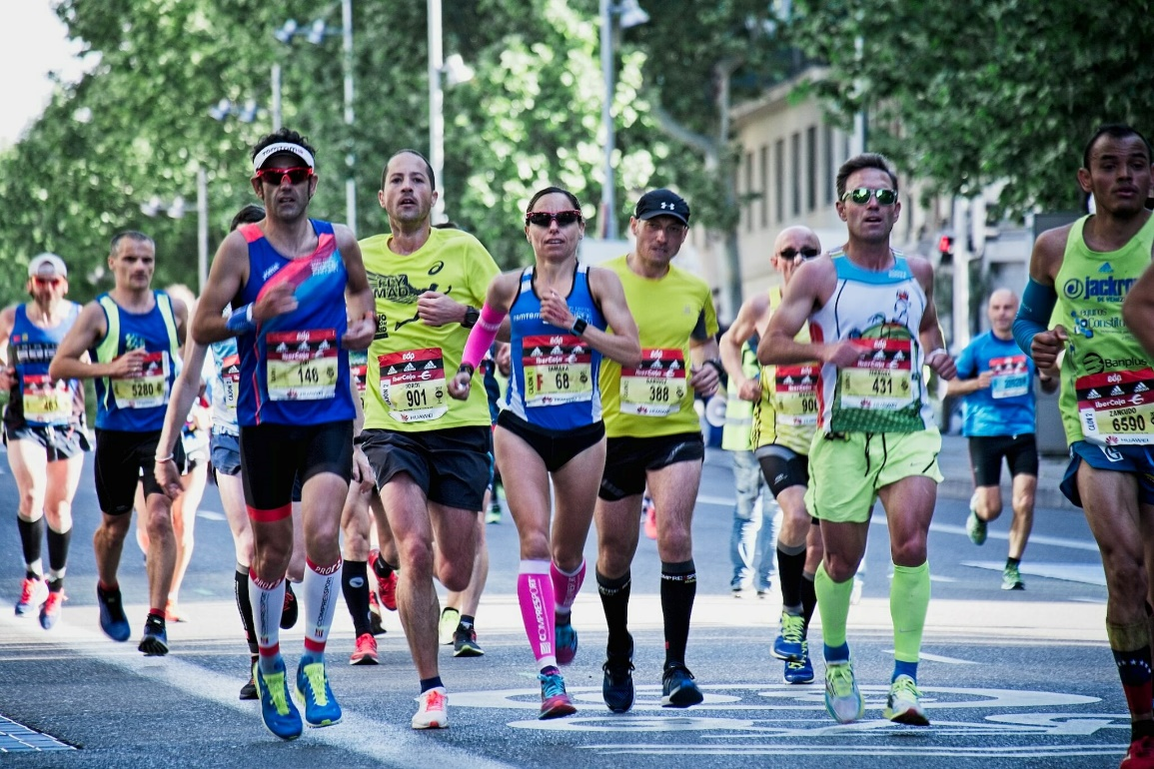
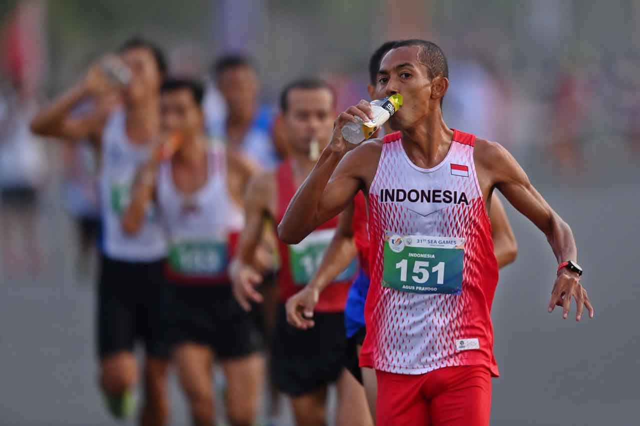
COMPARISON OF THE EFFECT OF CONSTANT INTENSITY ENDURANCE TRAINING WITH LOW INTENSITY INTERVAL TRAINING ON INCREASING AEROBIC ENDURANCE OF MIDDLE CLASS RUNNER
YOGI FADILAH
UNIVERSITAS PENDIDIKAN INDONESIA

Slide 2
INTRODUCTION
Aerobic endurance is one of the physical conditions that is very necessary for athletes in long-duration sports such as long-distance running or marathons (S.D. Sari & Suripto, 2021).
According to (Diyawitama, 2020) “The physical demands of long-distance running or marathons can cause runners to become exhausted, resulting in a decline in performance in the middle or after the race is finished.”
However, currently the trend of "running fever" has caused many runners who take part in competitions not to prepare their physical condition well, so they are at high risk of experiencing severe fatigue (Mutohir et al., 2023)
According to (Putra & Wulandari, 2023) “Aerobic endurance is the main component for long-distance runners (marathons), because aerobic capacity functions to absorb and deliver oxygen to the muscles, as part of the process of burning fat into energy.”
Therefore, an endurance training method is needed that has an influence on increasing aerobic endurance in middle class runners, such as Constant Intensity Endurance Training (Fajriyudin et al., 2021) and Low Intensity Interval Training (Mubarok & Kharisma, 2022).

Slide 3
PROBLEM FORMULATION
RESEARCH OBJECTIVES
Is there a significant effect of Constant Intensity Endurance Training on increasing the aerobic endurance of middle class runners?
Is there a significant effect of Low Intensity Interval Training on increasing the aerobic endurance of middle class runners?
Does Constant Intensity Endurance Training have a more significant effect than Low Intensity Interval Training on increasing the aerobic endurance of middle class runners?
To examine the significant effect of Constant Intensity Endurance Training on increasing the aerobic endurance of middle class runners.
To examine the significant effect of Low Intensity Interval Training on increasing the aerobic endurance of middle class runners.
To examine whether Constant Intensity Endurance Training has a more significant influence than Low Intensity Interval Training on increasing the aerobic endurance of middle class runners.

Slide 4
Experimental method
Purposive Sampling
Two groups pretest posttest group design
The population in this study was middle class runners in the JONG BOBAR running community, the sample used was 10 male people who were divided into 2 groups using the A-B-B-A ordinal pairing technique.
The research instrument used was the 2.4 km Running Test.
Data analysis
1). Normality test
2). Homogeneity test
3). Paired Sample T-Test
4). Independent Sample T-Test
METHOD

Slide 5
RESULT

Slide 6
The CIET provides an increase in the aerobic endurance of middle class runners due to several factors such as cardiovascular adaptation in middle class runners which stimulates and increases the efficiency of the heart and lungs, as well as increasing the body's capacity to transport oxygen. This is in line with research conducted (Faisal & Indrayogi, 2021) that training with continuous methods such as constant intensity endurance training is an effective method for increasing aerobic endurance
This LIIT method has been proven to have a significant effect on increasing the aerobic endurance of middle class runners, explained in the study (Jatmikanto, 2023) that interval training has a system that can be adjusted to the needs of athletes by repeating and continuing with recovery with a certain ratio. In addition, this exercise can improve and increase the level of physical performance such as minimizing the production of lactic acid in muscles, oxygen absorption and maximum aerobic capacity
Although constant intensity endurance training is more superior, in fact the findings prove that constant intensity endurance training does have a better effect than low intensity interval training by looking at the average results of the Posttest-pretest of both methods, but after statistical calculations were carried out, it was proven that there was no significant difference in the effect on increasing the aerobic endurance of middle class runners between constant intensity endurance training and low intensity interval training. Both have the same increase but none is superior in increasing aerobic endurance (VO2max).
DISCUSSION

Slide 7
There is a significant influence of Constant Intensity Endurance Training on increasing the aerobic endurance of middle class runners.
There is a significant influence of Low Intensity Interval Training on increasing the aerobic endurance of middle class runners.
There is no significant difference in the influence between Constant Intensity Endurance Training and Low Intensity Interval Training on increasing the aerobic endurance of middle class runners.
CONCLUSSION

Slide 8
Anshori, R. F. (2015). Ridwan Firdaus Anshori, 2015 Perbandingan Metode Continous Training Dan Interval Training Terhadap Peningkatan Daya Tahan Aerobik Pada Atlet Sepakbola Universitas Pendidikan Indonesia | Repository.Upi.EduPerpustakaan.Upi.EduHttp://Repository.Upi.Edu/Id/Eprint/17374.
Diyawitama, F. (2020). Analisis Hubungan Kelelahan (Fatigue) Dengan Keseimbangan (Balance) Pada Pemain Futsal Usia Binaan. Energy For Sustainable Development: Demand, Supply, Conversion And Management, 1–14.
Faisal, M. A., & Indrayogi, I. (2021). Pengaruh Metode Latihan Kontinu Dan Interval Terhadap Peningkatan Daya Tahan Aerobik Pemain Futsal Marfyana. Research Physical Education And Sports, 3(1), 1–6.
Fajriyudin, M., Aminudin, R., & Fahrudin, F. (2021). Pengaruh Metode Continuous Running Terhadap Peningktan Daya Tahan Siswa Ekstrakurikuler Pencak Silat Di Pondok Pesantren Modern Nurussalam. Jurnal Literasi Olahraga, 2(1), 51–59. Https://Doi.Org/10.35706/Jlo.V2i1.4435
Jatmikanto Septa, R. (2023). Pengaruh Latihan Interval Terhadap Daya Tahan Aerobik Dan Daya Tahan Anaerobik Pemain Sepakbola Ditinjau Dari Daya Tahan Otot. 0, 1–23.
Mutohir, T. C., Maksum, A., & Kristiyanto, A. (2023). Laporan Indeks Pembangunan Olahraga Tahun 2023 Kebugaran Jasmani Dan Generasi Emas 2045. December.
Putra, A. P. H., & Wulandari, F. Y. (2023). Pengaruh High Intensity Interval Training (HIIT) Terhadap Imt Dan Aerobic Capacity Komunitas Lari Kabupaten Situbondo. Jurnal Prestasi Olahraga
Runacres, A., Mackintosh, K. A., & Mcnarry, M. A. (2019). The Effect Of Constant-Intensity Endurance Training And High-Intensity Interval Training On Aerobic And Anaerobic Parameters In Youth. Journal Of Sports Sciences, 37(21), 2492–2498. Https://Doi.Org/10.1080/02640414.2019.1644890
Sari, S. D., & Suripto, A. W. (2021). Profil Kondisi Fisik Atlet Lari Jarak Jauh Klub Atletik Bima Cepu Kabupaten Blora. Indonesian Journal For Physical Education And Sport, 2(1), 398–402. Https://Journal.Unnes.Ac.Id/Sju/Index.Php/Inapes%0aprofil
Zakky Mubarok, M., & Kharisma, Y. (2022). Pengaruh Latihan Interval Terhadap Peningkatan Kapasitas VO2Max. Biormatika: Jurnal Ilmiah Fakultas Keguruan Dan Ilmu Pendiidkan, 8(1), 128–136. Http://Ejournal.Unsub.Ac.Id/Index.Php/FKIP
REFERENCES

