Slide 1
THE IMPACT of COMPLEMANTARY TRAINING on INCREASING AGILITY ENDURANCE in FEMALE FUTSAL PLAYERS
Diva Sahrani Primayudistya
Universitas Pendidikan Indonesia

Slide 2
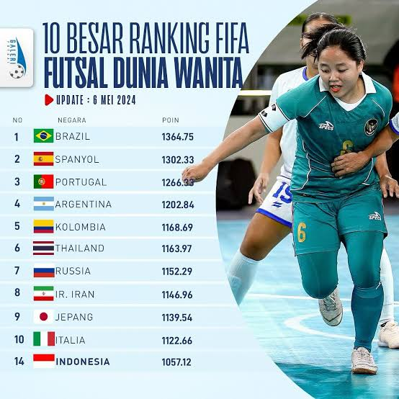
INTRODUCTION
➢ Condition Sport Achievement in Indonesia
➢ Physical Needs
➢ Agility Endurance
➢ Principle Individual
➢ Complementary Training
1

Slide 3
PROBLEM FORMULATION
RESEARCH OBJECTIVES​
Is there a significant impact of the application of Complementary Training on increasing Agility Endurance in female futsal players?
To assess the significant impact of the application of Complementary Training on increasing Agility Endurance in female futsal players.
2

Slide 4
RESEARCH METHODS
01
0 2
03
04
Research Methods​
Population and Sample
Research Instrument​
Experiment
Research design
One group pretest-posttest design
34 UPI Female Futsal Athletes
Purposive sampling
Shuttle Run 10x10 meters
0 5
06
Research Procedure
Percentage of Result
Hypothesis Test
Normality Test
Analysis Data​
Pretest – treatment - posttest
Data Description
3

Slide 5
RESEARCH RESULT
In the​ test beginning percentage of results obtained was 89%, while in the test the percentage of results was 96%. So there is difference of 7%, which means that female futsal players experience an increase in agility endurance of 7% from before and after being given complementary training
48

Slide 6
DISCUSSION
Complementary training has a significant impact​ on the agility endurance of female futsal players . This is because the concept of complementary training involves combining various training methods and principles that complement each other to achieve, optimal results , such as , integration of training methods , integrated periodization , individualization , reconciliation of​ conflicting concepts , and a holistic approach (Jovanović, 2019). And according to a supporting study ( Patru et al., 2016) said that complementary training shows an improvement complementary training can help coaches be able to understand the importance of physical condition for each different individual and become one​​ of the success factors for athletes competing. The results of the research conducted provide a real picture that complementary training has a significant impact​ on increasing the agility endurance of female futsal players.
5

Slide 7
CONCLUSION
I MP L ICATIONS
SUGGESTION
CONCLUSION
Increase knowledge for all parties to find out how to increase Agility Endurance in futsal players. Used by various​​​ party both by coaches and athlete coaches especially in team or sport team Complementary Training is one model that has been proven to increase agility endurance in female futsal players.
For coaches and trainers​ of each sports category to be able to apply the Complementary Training model to increase Agility Endurance
It is recommended that further research can be carried out complementary training research that designs with the recovery training process.
Complementary Training is one model that has been proven to increase agility endurance in female futsal players.
6

Slide 8
References
Berdejo-del-Fresno, D. (2014). A Review about Futsal. American Journal of Sports Science and Medicine, 2(3), 70–70. https://doi.org/10.12691/ajssm-2-3-0
Carter, J., & Greenwood, M. (2014). Complex training reexamined: Review and recommendations to improve strength and power. Strength and Conditioning Journal, 36(2), 11–19. https://doi.org/10.1519/SSC.0000000000000036
Complementary training in football: improve your performance and prevents injuries. (2023). Futbollab. https://www.futbollab.com/en/news/complementary-training-in-football-improve-your-performance-and-prevents-injuries#
Dikdik Zafar Sidik. (2019). Prinsip latihan Dalam Olahraga. Wordpress. Com.
Jovanović, M. (2019). Strength Training Manual vol.1.
Lhaksana, J. (2011). Taktik \& Strategi Futsal Modern. Be Champion. https://books.google.co.id/books?id=ANtjCgAAQB
Mansur, L. K., Irianto, J. P., & Mansur, M. (2018). Pengaruh latihan squat menggunakan free weight dan gym machine terhadap kekuatan, power, dan hypertrophy otot. Jurnal Keolahragaan, 6(2), 150–161. https://doi.org/10.21831/jk.v6i2.16516
Patru, L., Negulescu, I., Ciurea, C., & Angelescu, L. (2016). The Effects of the Complementary Training on Coaching the Non-Dominant Side in Karate Shotokan. 398–404. https://doi.org/10.15405/epsbs.2016.06.55
Urichianu, S. T. (2017). Pendekatan Baru dalam Sosial dan Ilmu Kemanusiaan.

