Slide 1
A DESCRIPTIVE KUALITATIVE STUDY ON NEWS COVERAGE KANJURUHAN EVENTS ON INTERNET MEDIA IN OCTOBER 2022
Sri Wulandari
Malang State University

Slide 2
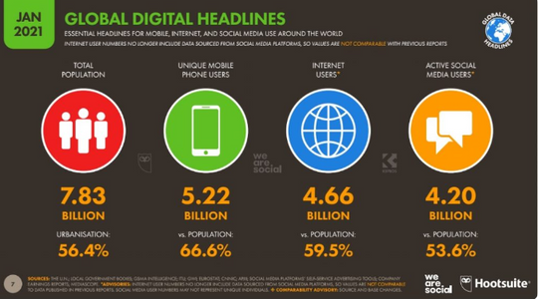
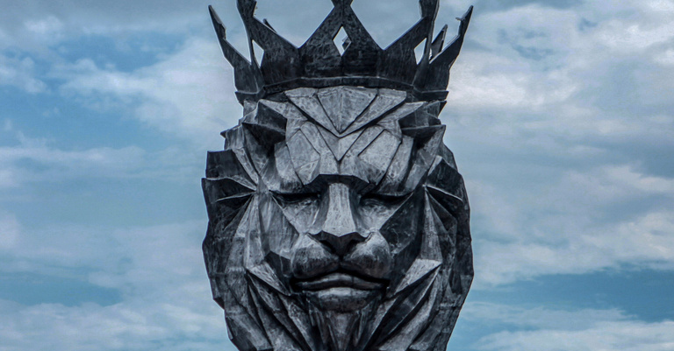
INTRODUCTION
THERE ARE INDUSTRIAL REVOLUTION 4.0
ACCORDING TO DATA FROM WE ARE SOCIAL AND HOOTSUITE (2021)
THERE WAS A POST AFTER MATCH FORM AREMA FC VS PERSEBAYA
Sri Wulandari – August 08th 2024

Slide 3
LITERATURE REVIEW
INDONESIAN FOOTBALL
KANJURUHAN TRAGEDY
TAKSONOMY SPECTATOR IDENTITY BY RICARD GIULIANOTTI
Sports is one of the fields that is popular with people around the world. One of the most popular sports is football (Putra, 2021). Football is a sport using a ball played by two teams, each consisting of 11 (eleven) people. Where both teams try to put as many balls into the opponent's goal as possible to score goals (Amiq, 2016)
The tragedy that occurred at the Kanjuruhan Stadium, Malang Regency in October 2022 has become a public concern (Pratama, D. E., & Apriani, 2023). The Kanjuruhan incident was a riot that occurred after the match between Arema FC and Persebaya in League 1 (Sausina, 2022). This riot occurred due to Arema FC supporters' dissatisfaction with the final result of the match, which resulted in taking to the field as a form of protest. Seeing the action on the field carried out by several Arema FC supporters.
).
Traditional/Hot Sector Supporters
Traditional/Cool Spectators: Followers
The Hot/Consumer Spectators: Fans
Cool/Consumer Spectators: Flaneurs
Sri Wulandari – August 08th 2024

Slide 4
LITERATURE REVIEW
DEFINITION INTERNET
MEDIA
THE INTERNET AS A NEWS MEDIA
According to the Big Indonesian Dictionary (KBBI), media is a tool (means) of communication, such as newspapers, magazines, radio, television, posters, films and banners. Then "Internet" is an electronic communications network that connects organized computer networks and computer facilities throughout the world via telephone or satellite. The internet is a form of new media in the 21st century.
Since Internet information technology became known in society around the 1990s, it has also been used in the mass media. In terms of communication technology via the Internet, news distribution can be done quickly, and can even be accepted by the general public through online news portals. The concept or definition of news may also begin to change. The definition of news, which previously meant "reporting events that have occurred," has now changed its meaning to "reporting events that are currently occurring" (Haryanto, 2014) in (Waluyo, 2018).
Sri Wulandari – August 08th 2024

Slide 5
METHOD
TAKSONOMY SPECTATOR IDENTITY BY RICARD GIULIANOTTI
RESEACRH STUDY | POPULATION AND SAMPLE | INSTRUMENT RESEARCH
This research is included in qualitative research using a descriptive approach | Two news portals: CNN Indonesia and Detik.com using purposive sampling | Indirect Observation (Secondary)
).
Sri Wulandari – August 08th 2024

Slide 6
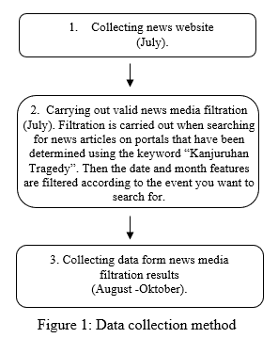
COLLECTING DATA METHOD
The data collection used is digital library research using a Narrative Inquiry approach, because the data taken by researchers is the result of symptoms, views and experiences of an individual or group (Khoirunnisa et al., 2021).
Steps :
Sri Wulandari – August 08th 2024

Slide 7
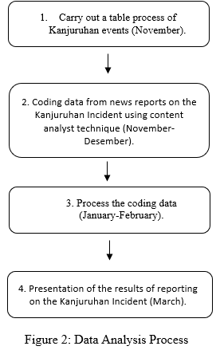
DATA ANALYSIS TECHNIQUE
Content Analysis Technique (Sparkes & Smith, 2014) in Assidiqqi, 2022) using Content Analyst (Ahmad, 2018).
Sri Wulandari – August 08th 2024

Slide 8
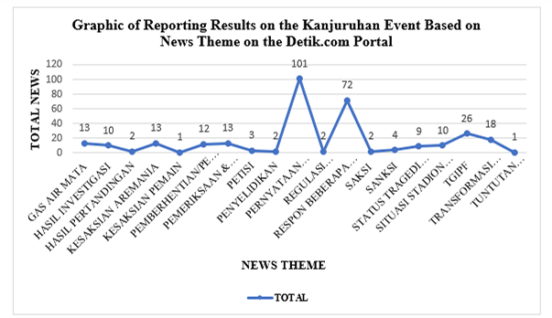
FINDINGS AND DISCUSSION
The purpose of the research is to explain how the causes of the Kanjuruhan incident until it was reported in the internet media and to describe the hronology of the news of the Kanjuruhan incident in the internet media. After conducting the research, the following results were obtained:
Sri Wulandari – August 08th 2024

Slide 9
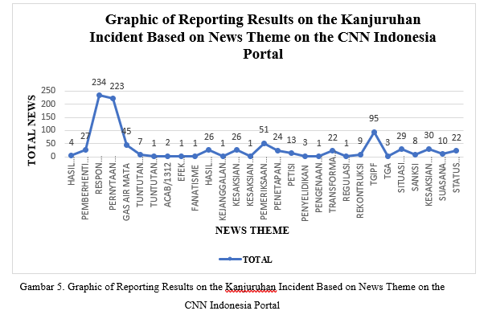
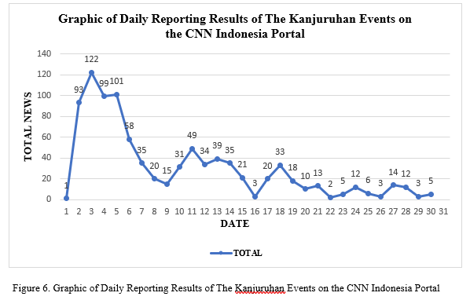
FINDINGS AND DISCUSSION
Sri Wulandari – August 08th 2024

Slide 10
CONCLUTION
Based on the results of the research that has been carried out and the results and discussions described above regarding the reporting of the Kanjuruhan incident on the internet media in October 2022, the results obtained are that in 2 news portals, namely Detik.com and CNN Indonesia. In the news portal Detik.com, a total of 317 reports were found, many of which were about "Statements from several parties", namely a total of 219 reports released and in the daily news the most were released on October 3 2022 with a total of 61 reports. Meanwhile, on the CNN Indonesia portal, a total of 920 news reports were obtained, most of which were included in "Response from several parties", namely with a total of 234 reports released and in the daily news the most was released on October 3 2022 with a total of 122 reports. From the data obtained, it can be seen that the news about the Kanjuruhan incident has been reported chronologically.
Sri Wulandari – August 08th 2024

