Slide 1
COMPARISON OF THE EFFECT OF PADDLE RESISTED TRAINING AND FIN ASSISTED TRAINING ON 50 M FREE STYLE SWIMMING SPEED
Erlangga Dirgantara – 2005405
UNIVERSITAS PENDIDIKAN INDONESIA

Slide 2
INTRODUCTION
In swimming, speed is the benchmark when athletes compete.
To increase speed, arm and leg muscle strength is required
Paddle Resisted Training
Fin Assisted Training
Whether these two exercises can influence the 50m freestyle swimming speed?
Erlangga Dirgantara

Slide 3
INTRODUCTION
Paddle Resisted Training is a form of training that aims to increase the strength of the swimmer's hands by increasing the resistance or load that the swimmer must face, so that the swimmer's hand pull becomes strong and the endurance of his hands will increase (Maglischo, 2003).
Fin Assisted Training is a form of training that aims to increase the pull of the hand while in the water without reducing the length of the pull, and also increases the swimmer's ability to apply force over a longer distance without reducing the speed of the swimmer's pull and leg kick (Maglischo, 2003).
Erlangga Dirgantara

Slide 4
METHODS
POPULATION
Akssa Swimmig Club athletes totaling 15 people
RESEARCH DESIGN
Two-group pretest-posttest
RESEARCH FLOW
EXPERIMENTAL METHOD
SAMPLE
10 Akssa swimming club athletes, age range 9-12 years, have participated in competitions and intensive training. which are divided into 2 groups
RESERCH INSTRUMENT
Pre test and post test of freestyle sprint swimming with a distance of 50 m and timed using a stopwatch
DATA ANALYSIS
Descriptive Statistics
Data Normality Test
Homogeneity Testing
Hypothesis Testing
Erlangga Dirgantara

Slide 5
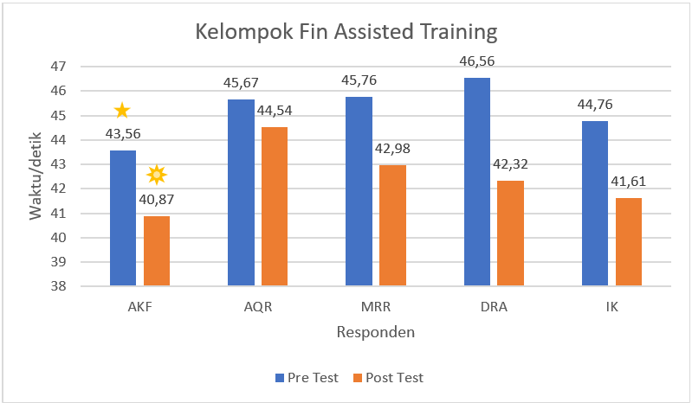
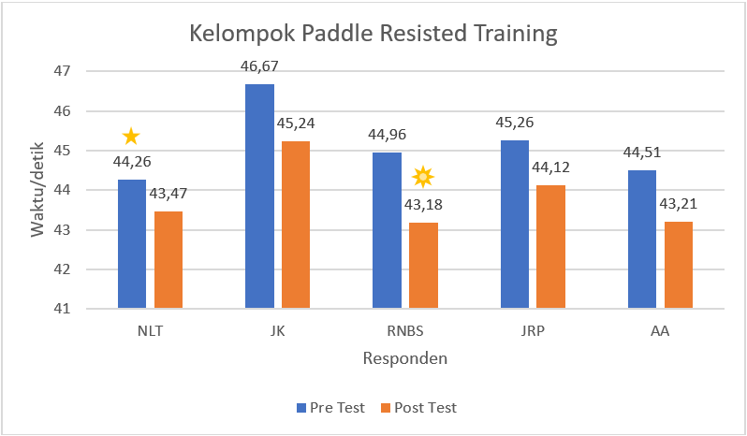
RESULT AND DICUSSION
FIN ASSITED TRAINING GROUP
PADDLE RESISTED TRAINING GROUP
Erlangga Dirgantara

Slide 6
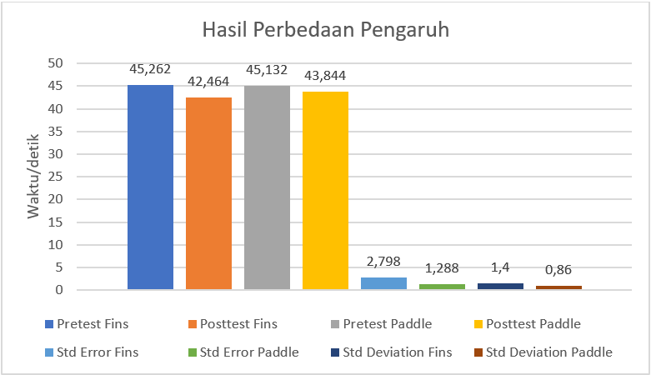
RESULT AND DICUSSION
Training using fins can increase swimming speed because training with the help of fins can make the foot kick fast so that the swimmer's hand stroke becomes faster than usual so that the resulting time increases (Maglischo, 2003).
Training using paddles can increase swimming speed also because paddles help the hand stroke feel heavier because there is resistance, so that when the swimmer releases the paddle the stroke will feel lighter and faster and the resulting time will increase (Maglischo, 2003).
The difference between fin and paddle increases swimming speed, so the difference is not too far because the training method and intensity of the program are the same (Febrianto, 2019).
DIFFERENCE IN EFFECT BETWEEN FIN AND PADDLE
Erlangga Dirgantara

Slide 7
CONCLUSION
There is a significant effect of paddle resisted training on 50m freestyle swimming speed.
There is a significant effect of fin assisted training on 50m freestyle swimming speed.
There is no significant difference in effect between paddle resisted training and fin assisted training on 50m freestyle swimming speed.
Erlangga Dirgantara

Slide 8
REFERENCES
Maglischo, E. W. (2003). Swimming fastest. Human Kinetics, Champaign, IL.
Febrianto, B. D. (2019). Pengaruh Penggunaan Hand Paddle Dan Fins Swimming Terhadap Kecepatan Renang Gaya Bebas Pada Atlet Renang Club Tirta Bima Majalengka.
Erlangga Dirgantara

Slide 9
THANK YOU
Erlangga Dirgantara

